Slide 1
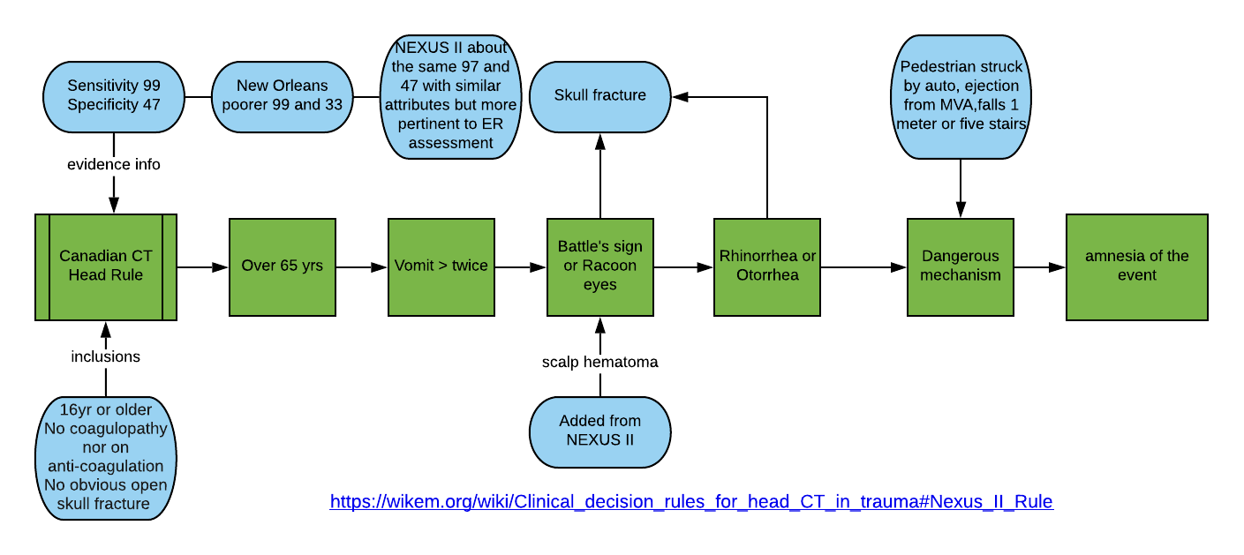
Need for Imaging Protocols
Notes:
The Canadian Head Rules is a protocol with high Sensitivity so that you can exclude serious injuries by excluding the need for CT scanning. If any of the green variables are present a CT is necessary. So if none are present the probability of a serious skeletal or neurological injury is small. The Canadian rules is better than the NEXUS and New Orleans in that it has a specificity than the NO and is more pertinent to us than the NEXUS which is more aimed at the ER with such things distracting injuries and intoxication.

Slide 2
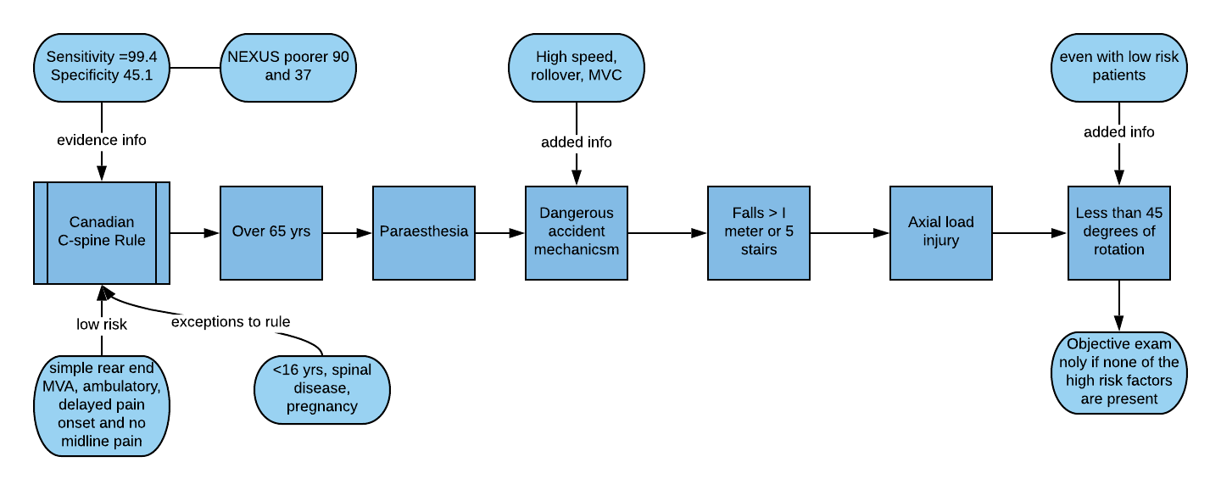
Notes:
Very similar to the head injury rules the Canadian Cspine protocol determines if imaging is necessary and by correleation if a serious injury is absent. High specificity ensures that serious conditions are excluded by the absence of any one of the variables in the center lane.

Slide 3
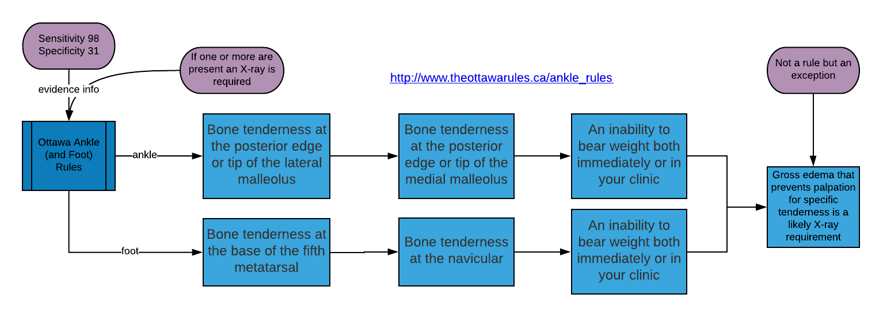
Notes:
Is imagaing necessary in an ankle foot injury. The Ottawa Ankle/foot Rule protocol says not if there are no risk factors listed above. If imaging is unnecessary then a serious injury is absent and physical therapy is OK.

Slide 4
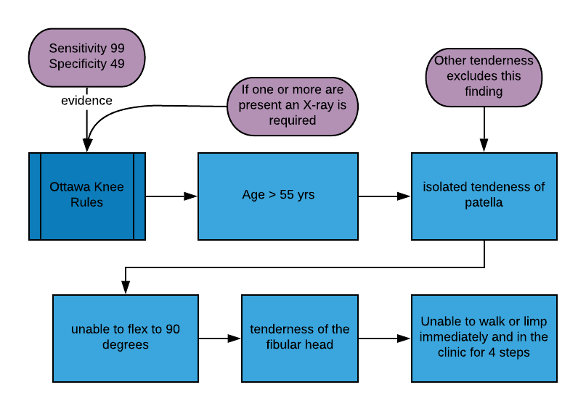
Notes:
If any of the five factors are present there is a real chance of serious damage and imaging is required. If not then you are good to go with physical therapy.

Slide 5
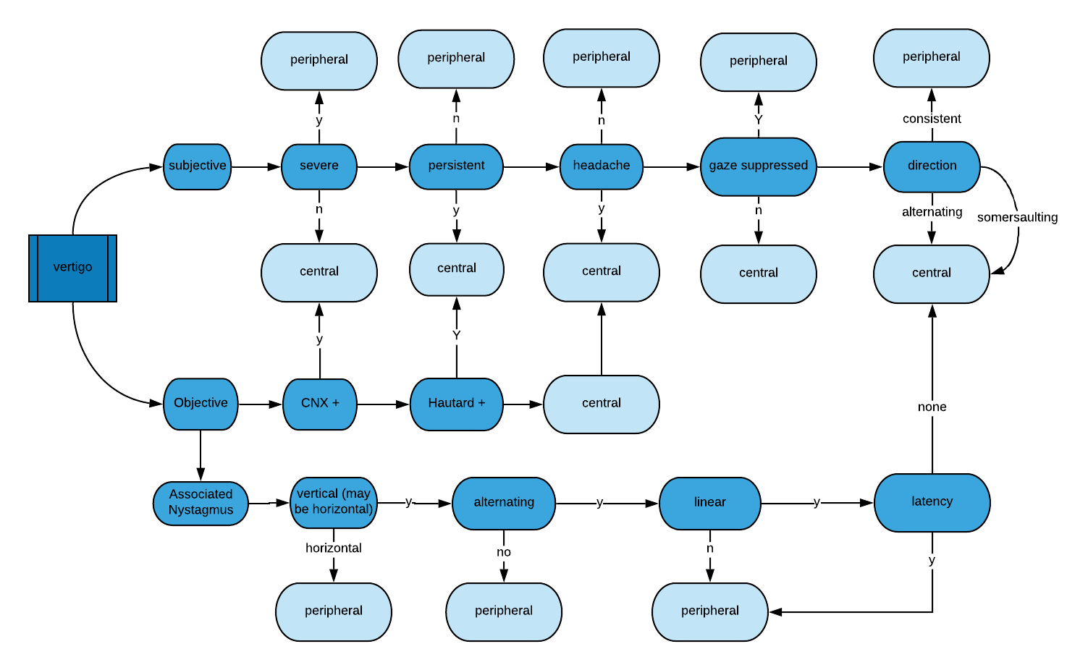
Dizziness and Headaches and VBI
Notes:
Determining whether vertigo is centrally or peripherally caused. The main initial indicators for central causation are; associated with neurological symptoms (definite) or headache; mild to moderate severity; persistence; alternating.

Slide 6
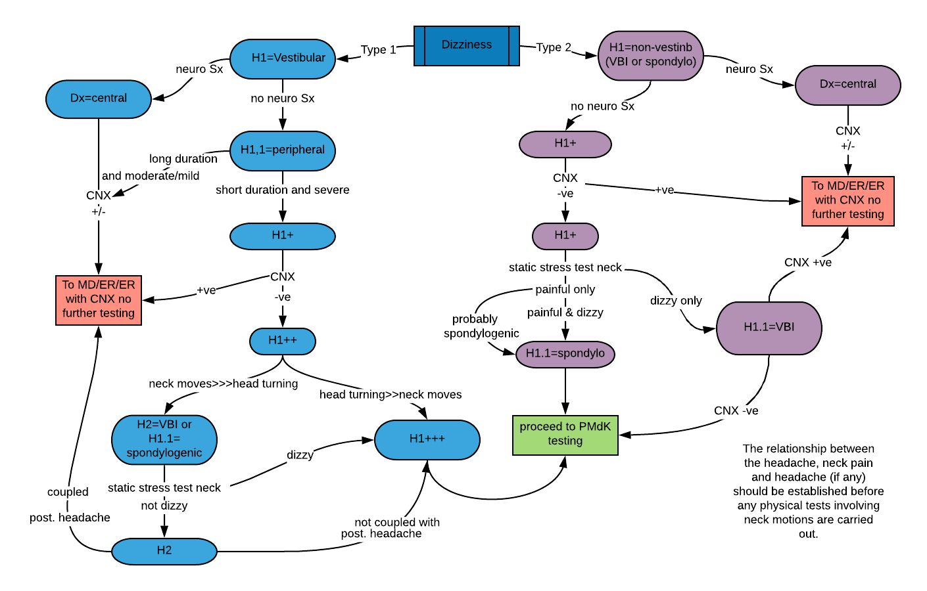

Slide 7
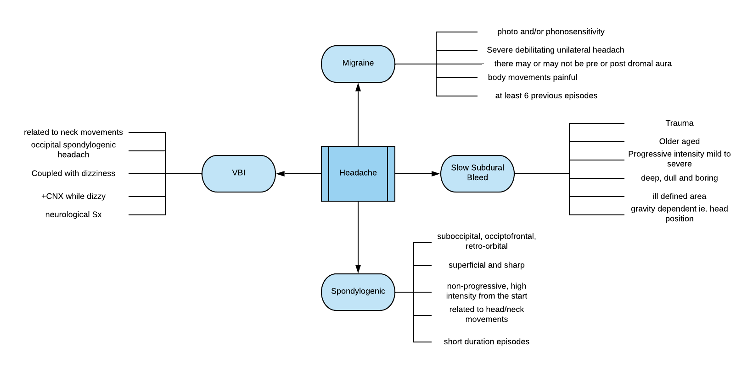
Notes:
Headache is a major symptom that may indicate a serious pathology so it is necessary to ensure that it is appropriate for treatment by us. The problem with migraine is that it is variable in it’s presentation. You can have migraine with headache or without headache and with or without aura. The common link with migraine headache is that it is severe, disabling, aggravated )by body movement and associated with photo or sonophobia (hypersensitivity). The diagnosis of migraine should not be made unless the patient has survived at least six previous episodes.

Slide 8
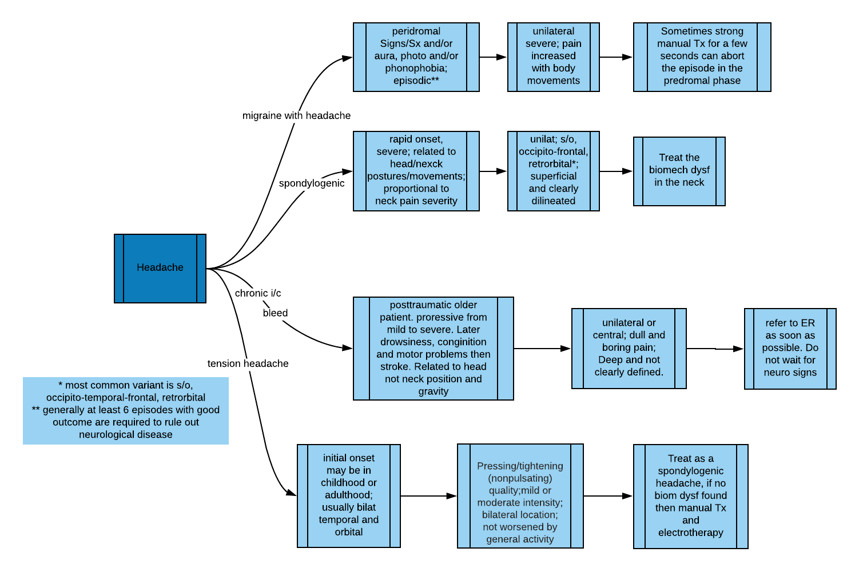
Notes:
Another way of looking at headaches

Slide 9
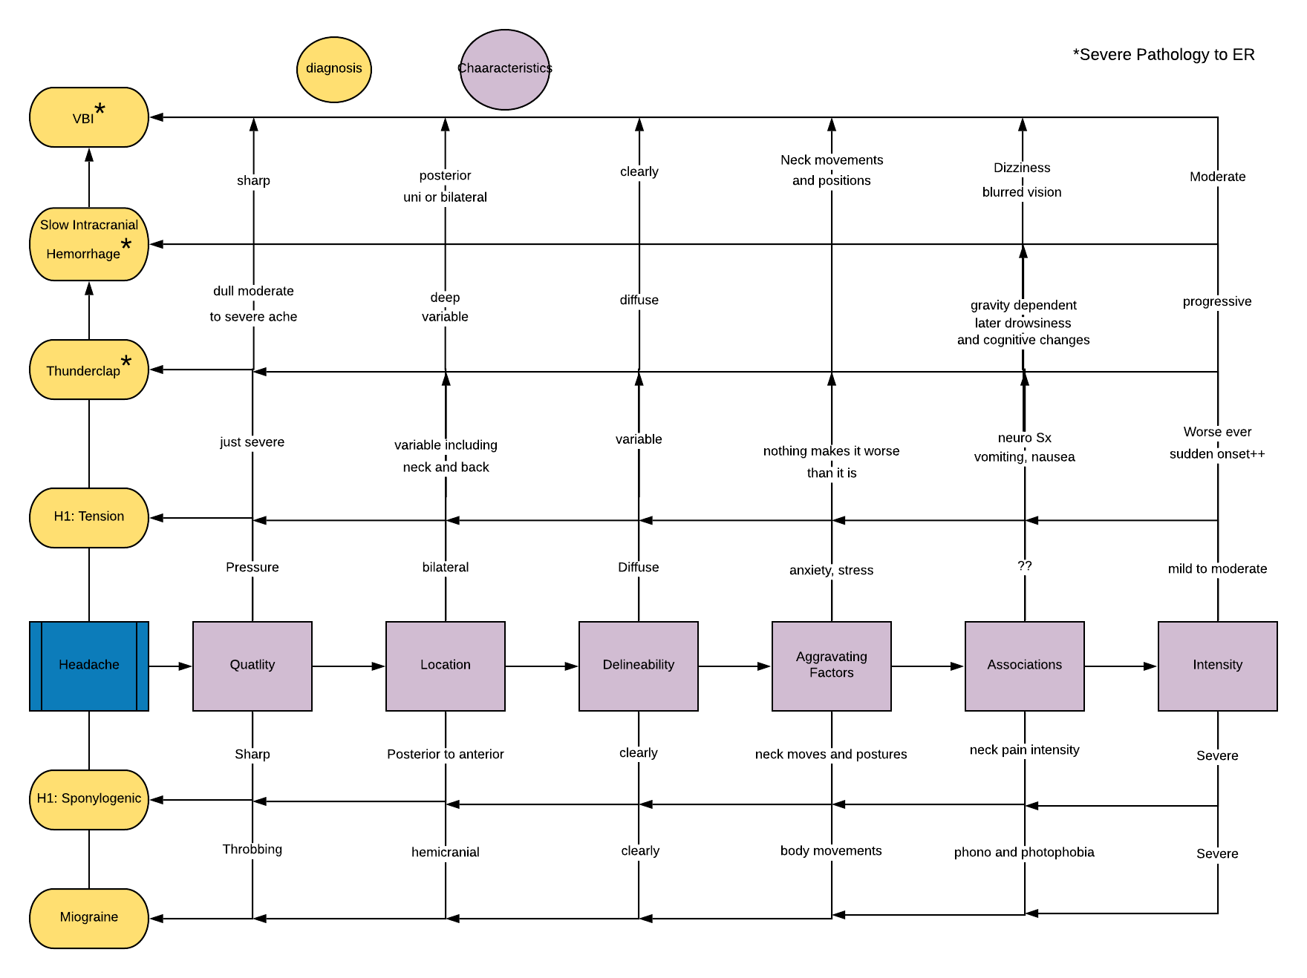
Notes:
And yet another way of looking at headaches.

Slide 10
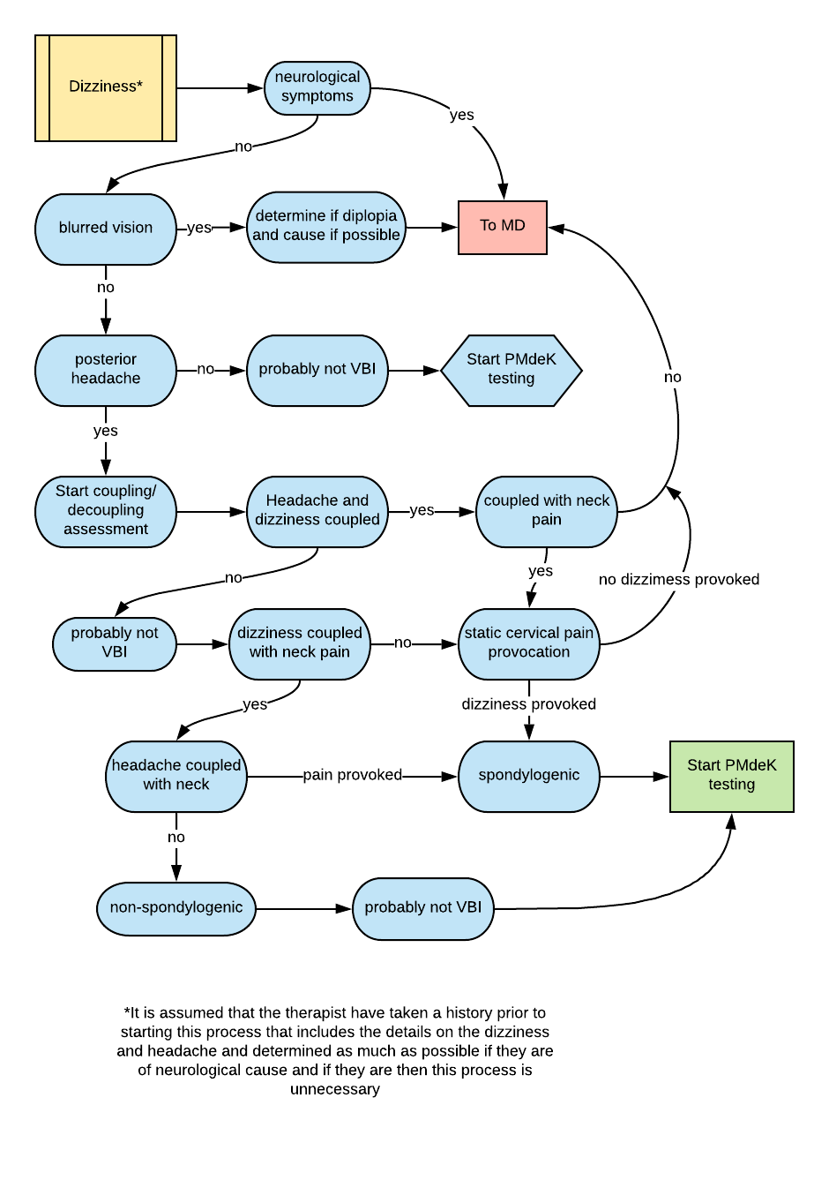
Notes:
This is discussing the relationship between the headache and the dizziness. Headache is the second most common symptom of traumatic VBI and is almost as common as dizziness.

Slide 11
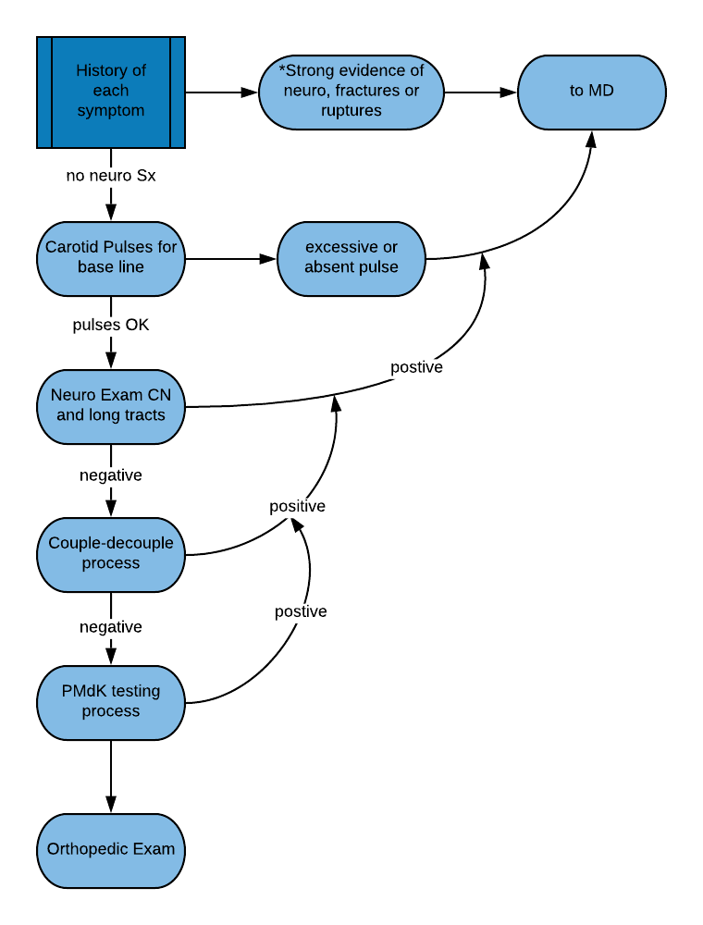
Notes:
This is an overview of a suggested exam sequence for those suffering from non-neurological symptoms of VBI, primarily headache and/or dizziness.

Slide 12
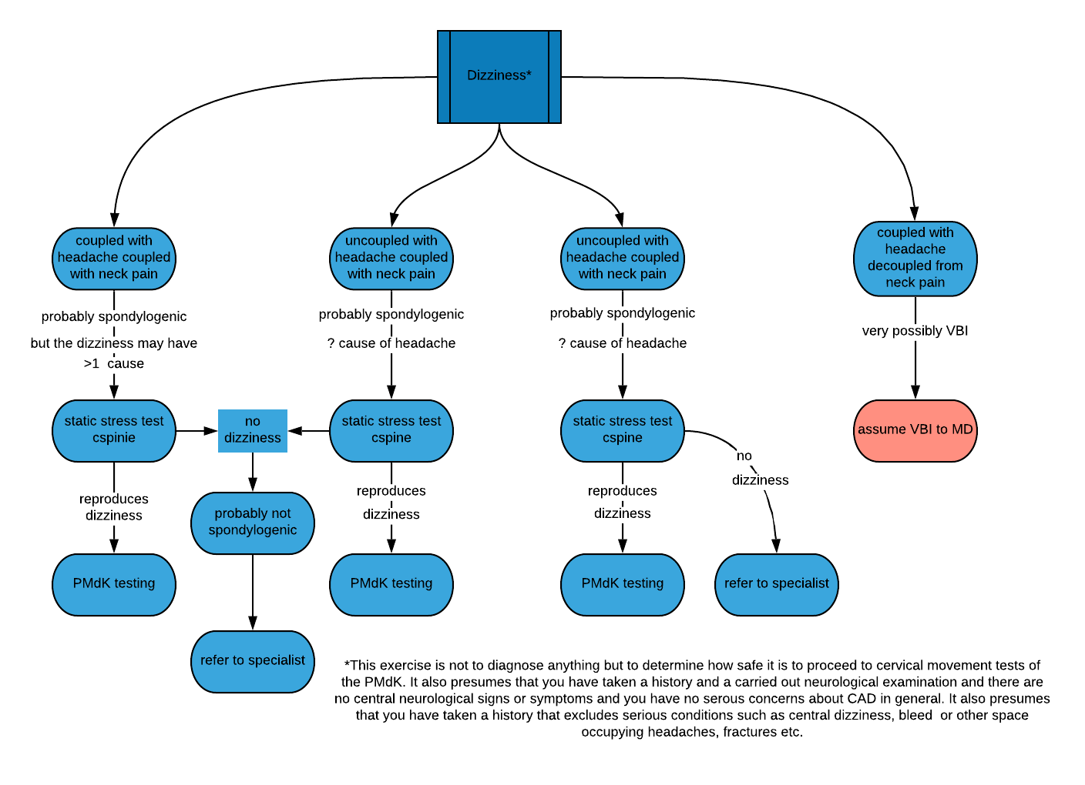

Slide 13
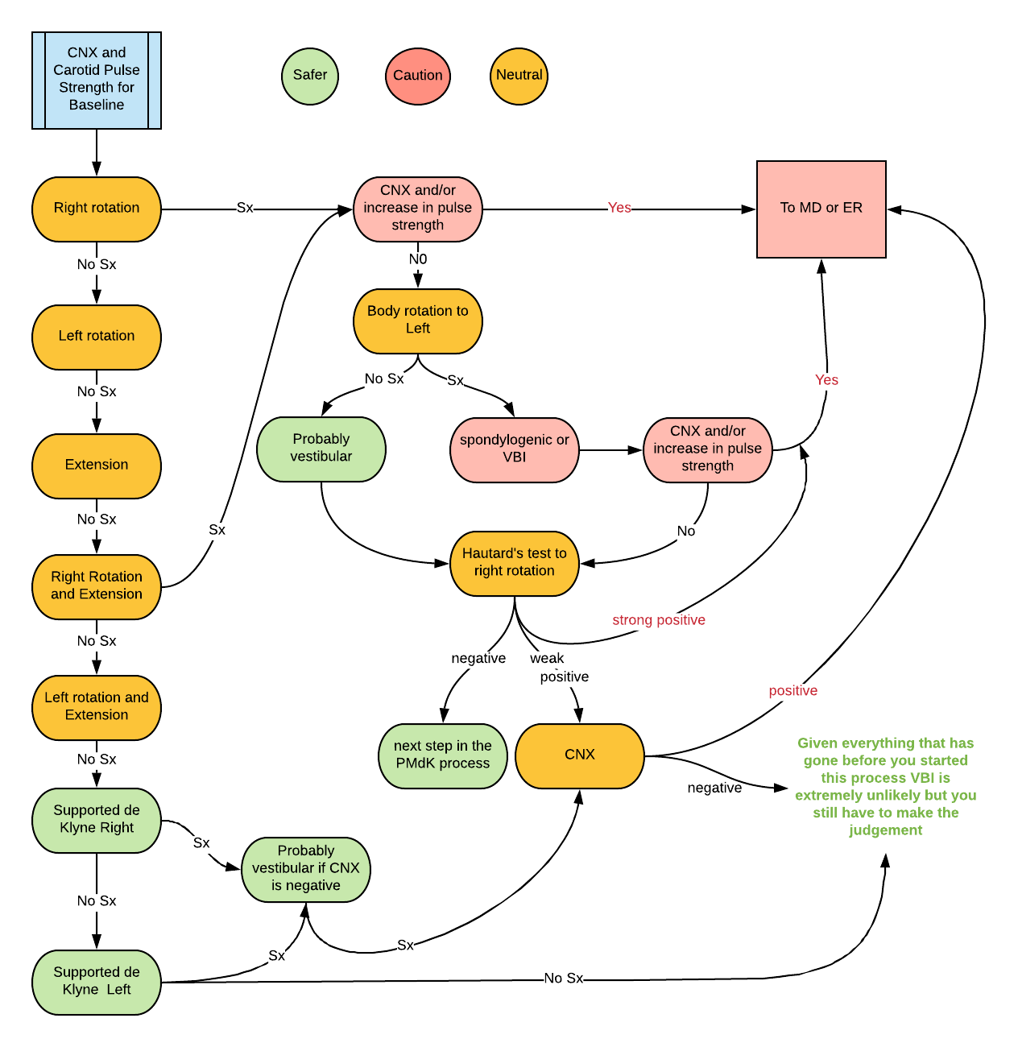
Notes:
This is the process of progressive minimized de Klyne testing. The first test is to reproduce the symptoms, the second phase is to differentiate the symptom and third is to take action.

Slide 14
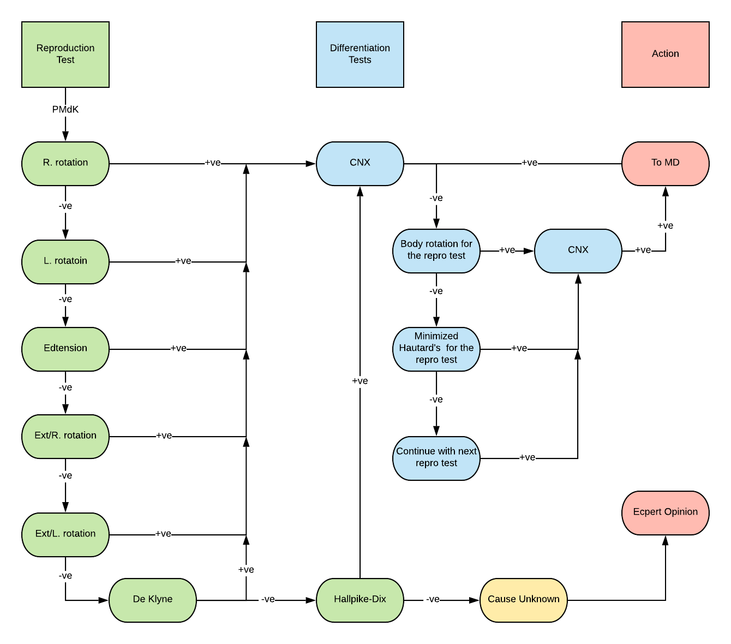
Notes:
The PMdK examination is for those patients that you are somewhat concerned about because they have either headache or dizziness. The point is to keep the neck movements to a minimum initially and gradually progress them as each proves not produce the symptoms. The differentiation tests are the CNX, Hautards and body rotation, these are done immediately when a reproduction test causes headache or dizziness and are done in the same position of the positive reproduction test. If the exam fails to produce the symptom then it’s up to you where you go from there but a second opinion would be in order.

Slide 15
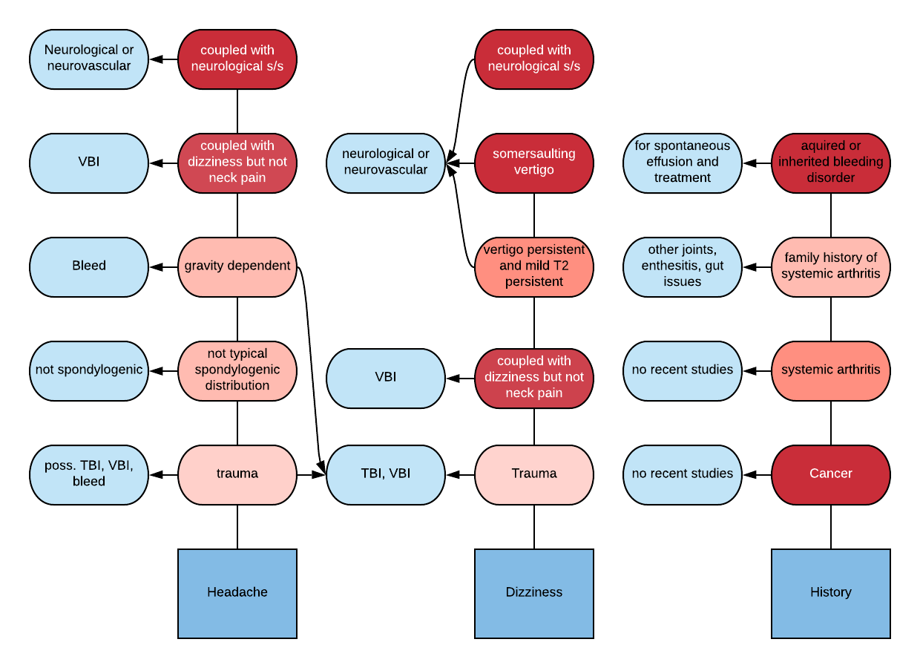
Notes:
These are reddish (red, orange, pink etc) flags related to headache and dizziness.

Slide 16
